Slide 1
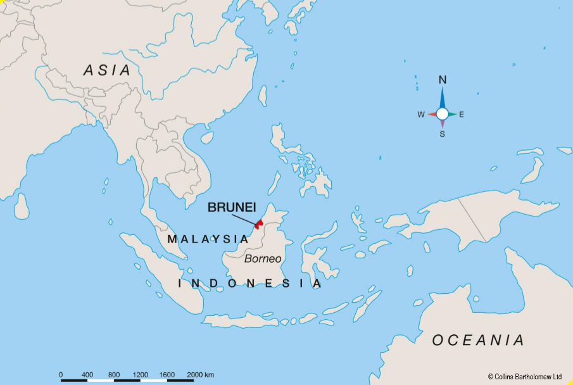
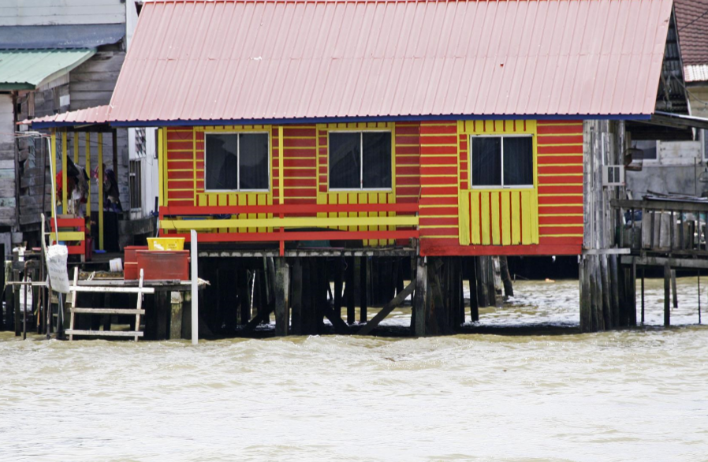
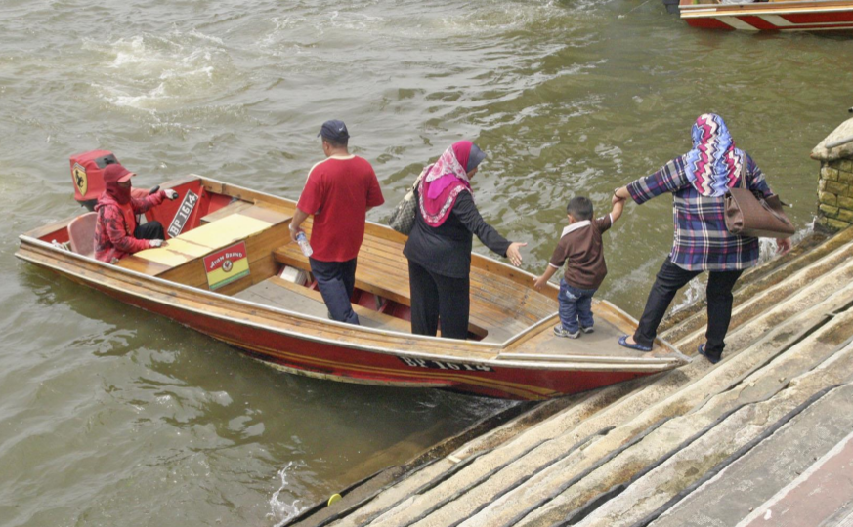
How does the geography of Kampong Ayer compare with the geography of where I live ?
Subject Specific Vocabulary |  |  | Key Questions
Kampong Ayer | Kampong Ayer is a small village settlement located mostly on the Brunei River in Brunei. |  | 1 – How does the location of Kampong Ayer compare with where I live? 2 – How do people’s homes at Kampong Ayer compare with mine? 3 – How does the weather at Kampong Ayer compare with the weather where I live? 4 – How do the people in Kampong Ayer travel around compared with how people travel around where I live? 5 – How does going to school in Kampong Ayer compare with my school? 6 – How does the natural environment around Kampong Ayer compare with the natural environment around where I live?
Equator | Invisible line around the centre of the world that divides the north and south hemisphere.
North and South Pole | Centre of the coldest places on earth, furthest away from the equator.
Continent | How the land of the world is divided up into 7 groups of countries. | Sticky Knowledge about Kampong Ayer
Location | Your position or place in a country within the world. | Kampong Ayer is about the same size area as the county of Devon and the same population as the city of Bristol in the United Kingdom.
Climate | Climate refers to aspects of weather over a long time. In hot countries the climate is normally warm. | Kampong Ayer is in the southern Hemisphere in Asia and the UK is in the Northern Hemisphere near Europe.
Transport | Means to travel from one area to another | Because Kampong Ayer is near the sea the river in which it has been built is affected by tides.
Water village | Group of houses making up a village, built in the middle of a wide river. | The weather in Kampong Ayer is hot and wet all year round.
Mud huts | Mud huts are basic houses built from what is available in the area. In Africa, mainly from mud. | Kampong Ayer is a village of mostly wooden buildings on stilts above a river and joined by boardwalks.
Tropical rainforest | Hot wet forest near the equator. | If you don’t own your own boat then a water taxi is vital for travelling from Kampong Ayer across the Brunei River.
Canopy | Upper parts of most of the trees | Most of the country of Brunei (in which Kampong Ayer is situated) is like – covered with tropical rainforest.

Slide 2
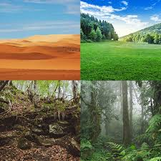
Year 2: Habitats Knowledge Mat
Subject Specific Vocabulary |  | Working Scientifically | Sticky Knowledge about habitats
habitat | A place where a particular animal or plants lives or grows naturally. | Asking simple questions and recognising that they can be answered in different ways. Observing closely, using simple equipment. Performing simple tests. Identifying and classifying. Using their observations and ideas to suggest answers to questions. Gathering and recording data to help in answering questions.
 |  |  | A habitat is a place where an animal or plant lives. It provides the animal or plant with the correct environment to live.
ecosystem | A group of plants and animals that interact with each other and form and ecological unit.
rivers | A river is a flowing, moving stream of water. Usually a river feeds water into an ocean, lake, pond, or even another river. |  | There are many different sorts of habitats around the world from forests to grasslands and from mountain slopes to deserts.
woodland | Woodland is a low-density forest with plenty of sunlight and limited shade.
 |  |  | Animals like cockroaches are really important in a habitat -they eat the dead plants and recycle the nutrients back into the soil.
ponds | A pond is a body of water smaller than a lake. Ponds support a very wide range of wildlife.
sea | A sea is part of the ocean partially enclosed by land. Seas are found on the margins of the ocean and are partially enclosed by land.
 |  | Common habitats
 |  |  | People are causing harm to many habitats. Forests are being burnt down, lakes and rivers polluted and the polar ice caps are melting.
rainforest | Tropical rainforests are forests with tall trees, warm climates and lots of rain.
desert | A desert is any large region that gets very little rain each year. Very few plants or animals live in desert areas.
 |  |  | Because resources like water and food may be limited, plant and animal species often compete with each other for food and water.
species | A group of animals, plants or other living things that all share common characteristics and that are all classified as alike in some manner.
 |  |  | Because the Earth is always changing, habitats are constantly changing.
microhabitats | Microhabitats are the small-scale physical requirements of a particular organism or a community of organisms.

Slide 3
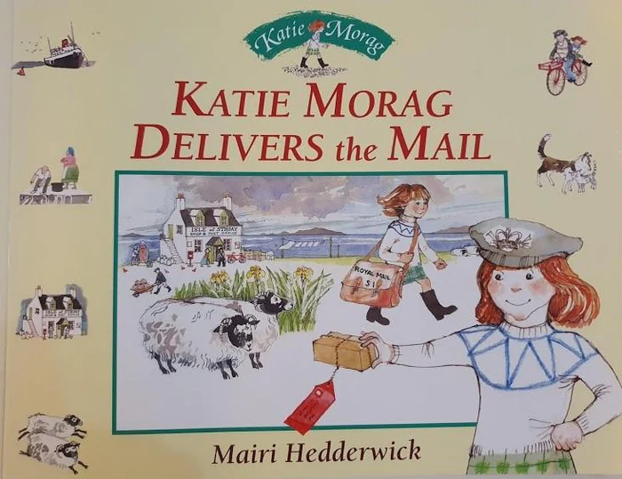
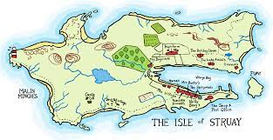
Year 2 - Whole Class reading
Subject Specific Vocabulary |  |  | Key Skills
island | A piece of land surrounded by water. |  | To read and infer meaning
ocean | A very large expanse of sea.
environment | The air, water and land in or on where people, animal and plants live.
mainland | Forming the main part of a country or continent, not including the islands.
atlas | A book of maps or charts.
transport | .Take or carry, people or goods, from one place to another using a vehicle, aircraft or ship.
British Isles | Group of islands in the North Atlantic North West of Europe, that consist of GB, Ireland, Isle of Man, the Hebrides and six thousand smaller islands.

